Slide 1
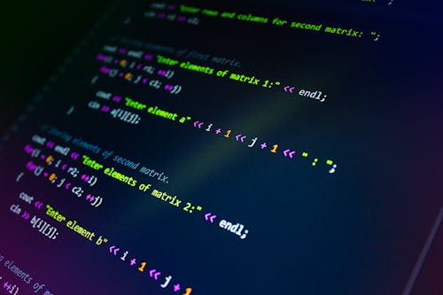
Machine Learning in Bioinformatics
A Simple Guide to Biology Meets Artificial Intelligence

Slide 2
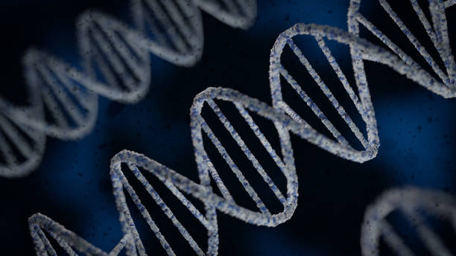
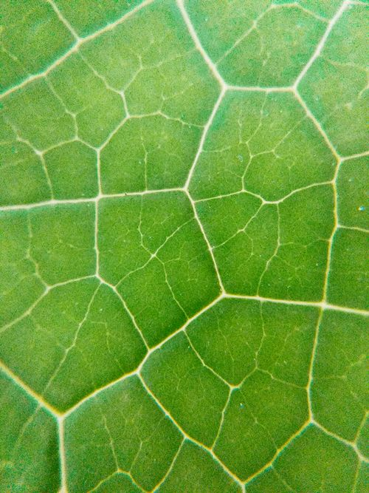
The Big Data Problem
Our bodies contain massive amounts of data hidden in our DNA. We have so much data that humans cannot read it alone. We need smart computers to help us.

Slide 3


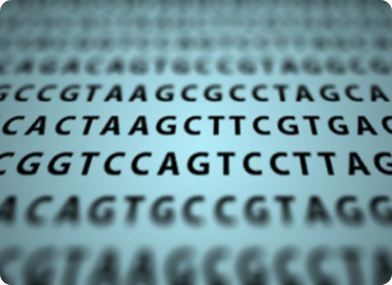
Reading the Code of Life
•
What is Genomics? The study of all of a person's genes (their genome).
•
The Challenge: A single human genome has over 3 billion letters of code. Searching for one mistake (mutation) is like finding a needle in a massive haystack.
•
The AI Solution: Machine learning algorithms can scan millions of DNA sequences in seconds to find the hidden patterns that cause diseases.

Slide 4
The Bioinformatics Workflow
STEP 2
STEP 4
Clean Data
Predict & Solve
Remove errors, organize the information, and prepare it for the computer.
Use the trained AI to diagnose diseases, find new drugs, or understand mutations.
STEP 1
STEP 3
Collect Data
Train Model
Gather biological samples (blood, tissue) and sequence the DNA or proteins.
Feed the data into an AI model so it can learn the rules and patterns of the biology.

Slide 5









How Computers Learn
Supervised Learning
Unsupervised Learning
Deep Learning
We give the computer examples with "answers." For example, showing it 1,000 pictures of healthy cells and 1,000 sick cells so it learns the difference.
We give the computer data without answers and ask it to find hidden groups. Great for discovering new, unknown types of diseases.
Advanced AI inspired by the human brain. It is highly powerful and is used for complex tasks like looking at medical images or 3D protein shapes.

Slide 6
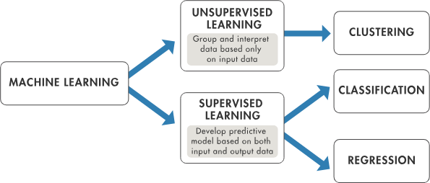

Slide 7
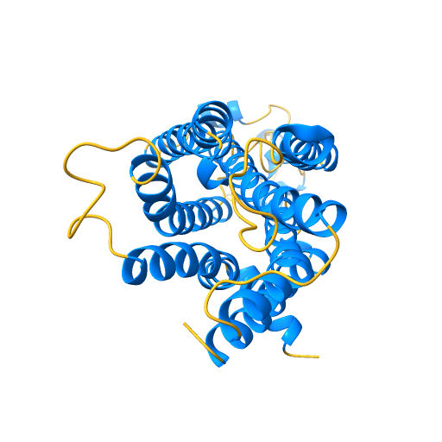
Predicting Proteins
The 3D Puzzle
Proteins are tiny machines that run our bodies. Their 3D shape determines what they do. If they fold into the wrong shape, it can cause diseases.
Figuring out a protein's shape used to take scientists years in a lab. Now, an AI called AlphaFold can predict protein shapes accurately in minutes, changing biology forever.

Slide 8
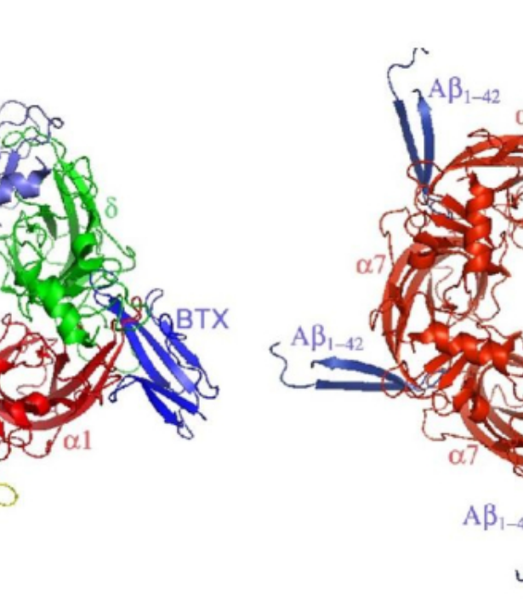
Creating New Medicines
Faster Drug Discovery
Inventing a new medicine usually takes 10-15 years and billions of dollars because scientists have to test millions of chemical combinations manually.
Machine learning simulates these tests on a computer. It can predict which chemical will cure a virus or shrink a tumor, saving years of trial and error.

Slide 9

The Future of Healthcare
•
Personalized Medicine: Instead of "one size fits all" treatments, AI will help doctors tailor medicine exactly to your unique DNA.
•
Early Detection: AI can spot the earliest signs of diseases like cancer in your blood long before you feel sick.
•
Virtual Experiments: More science will happen inside computer simulations rather than test tubes, speeding up human progress.

Slide 10
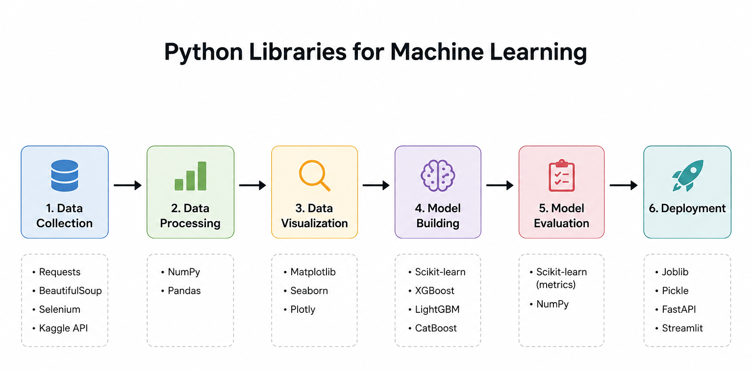

Slide 11
ML models and packages to implement in bioinformatics
Package / Model | Used For | Compatible With
ESM-2 | Protein Function & Stability | PyTorch, Biopython (FASTA)
Graphein | Protein 3D Structures/Graphs | PyTorch Geometric, Bio.PDB
ProtT5 | Functional Annotation | Hugging Face, Biopython
Selene | Genomic Variant Prediction | PyTorch, Bio.SeqIO
DeepChem | Drug-Target Interaction | Scikit-Learn, TensorFlow

Slide 12
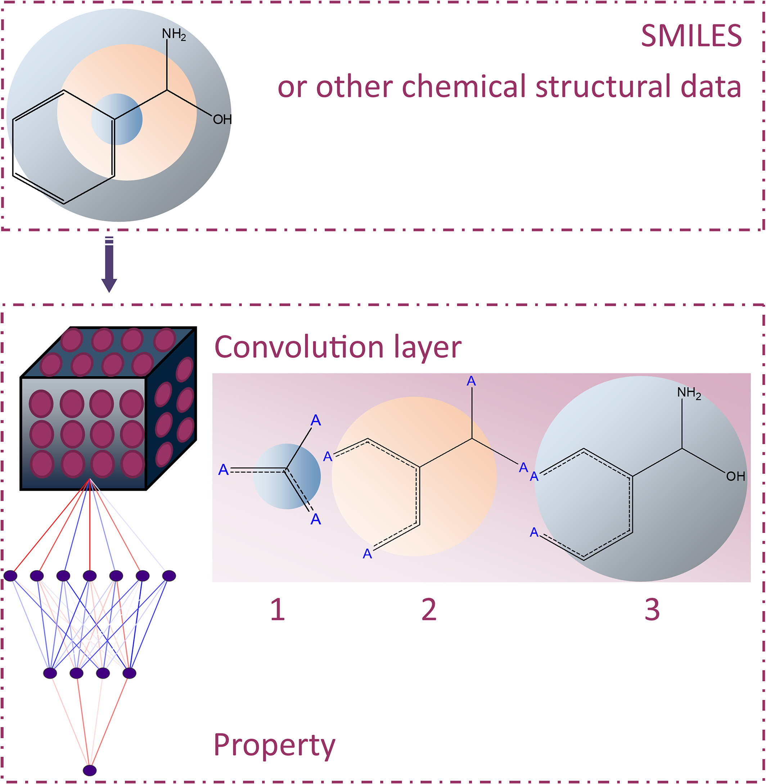
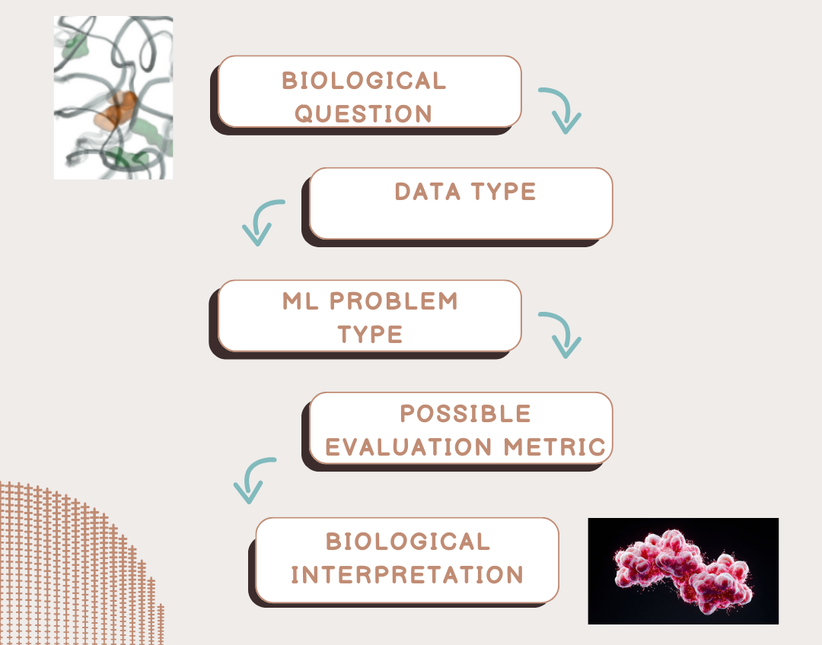

Slide 13
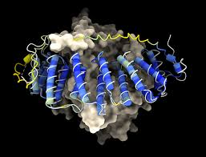
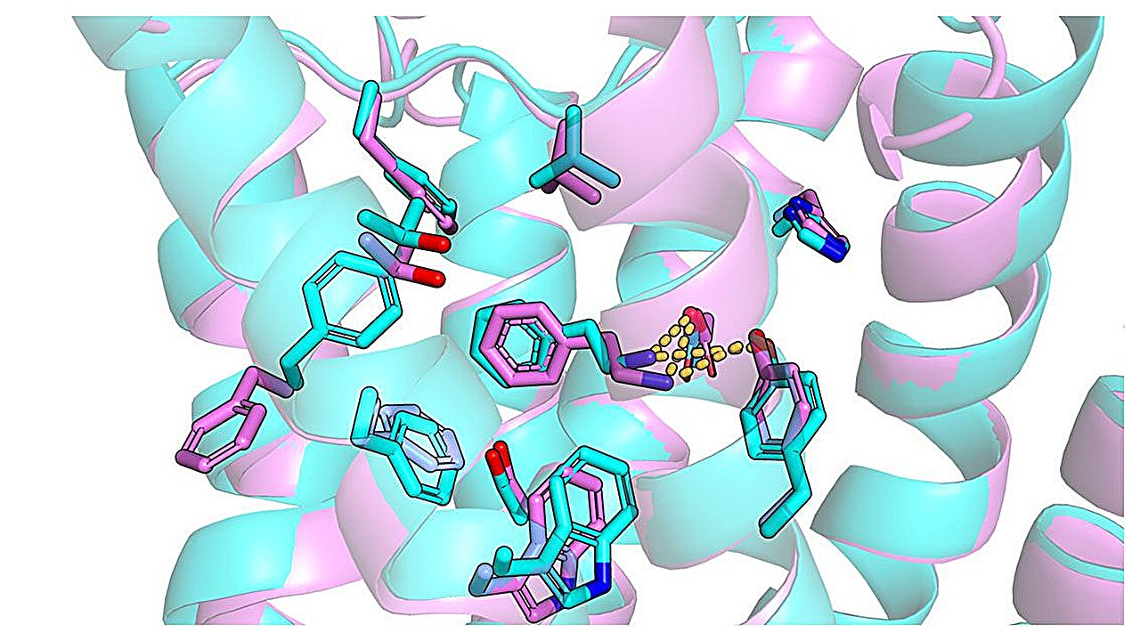
Implementation
1.Stucture Prediction(EsmFold)
2.Drug_receptor binding(py-torch)

Slide 14
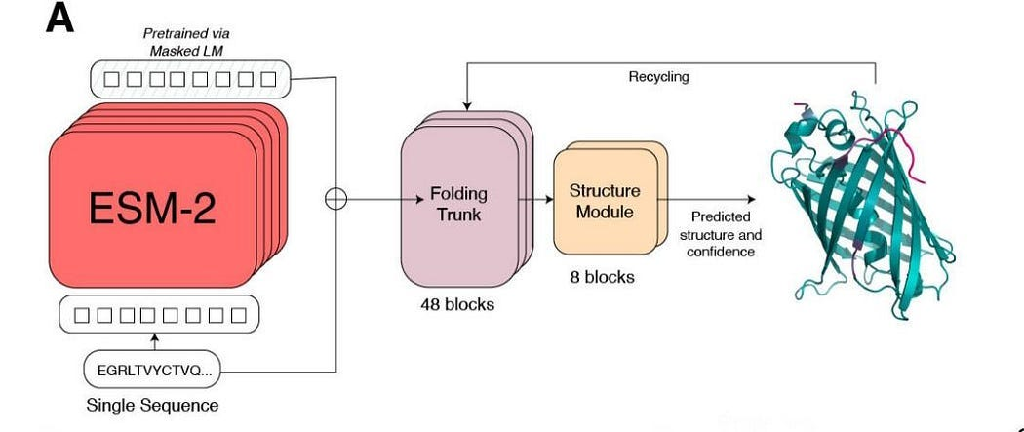
https://esmatlas.com/resources?action=fold

Slide 15
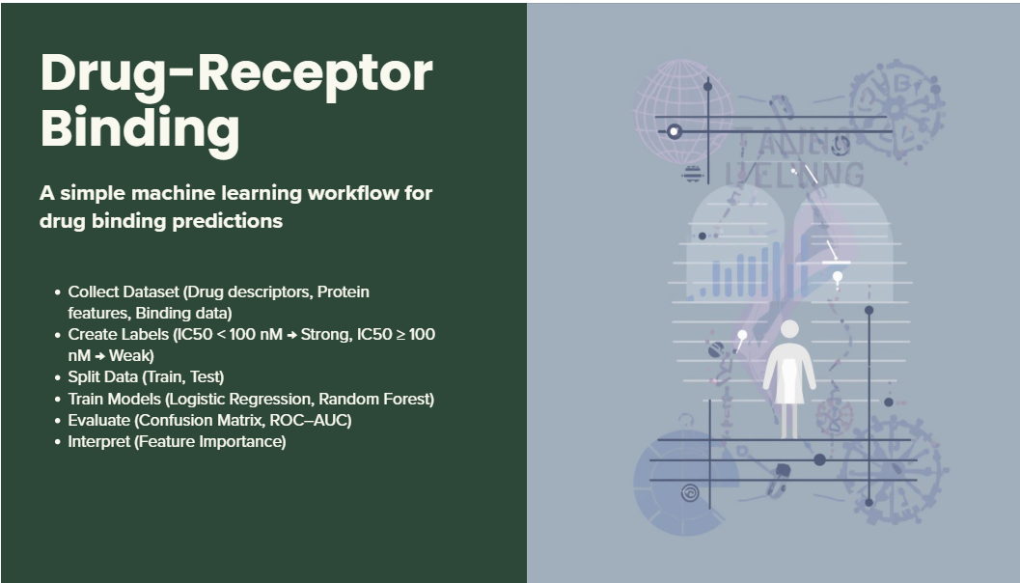
Drug_receptor binding Model
[ Data Collection ]
↓
[ Feature Extraction ]
↓
[ Train Model ]
↓
[ Evaluate Model ]
↓
[ Interpretation ]

Slide 16
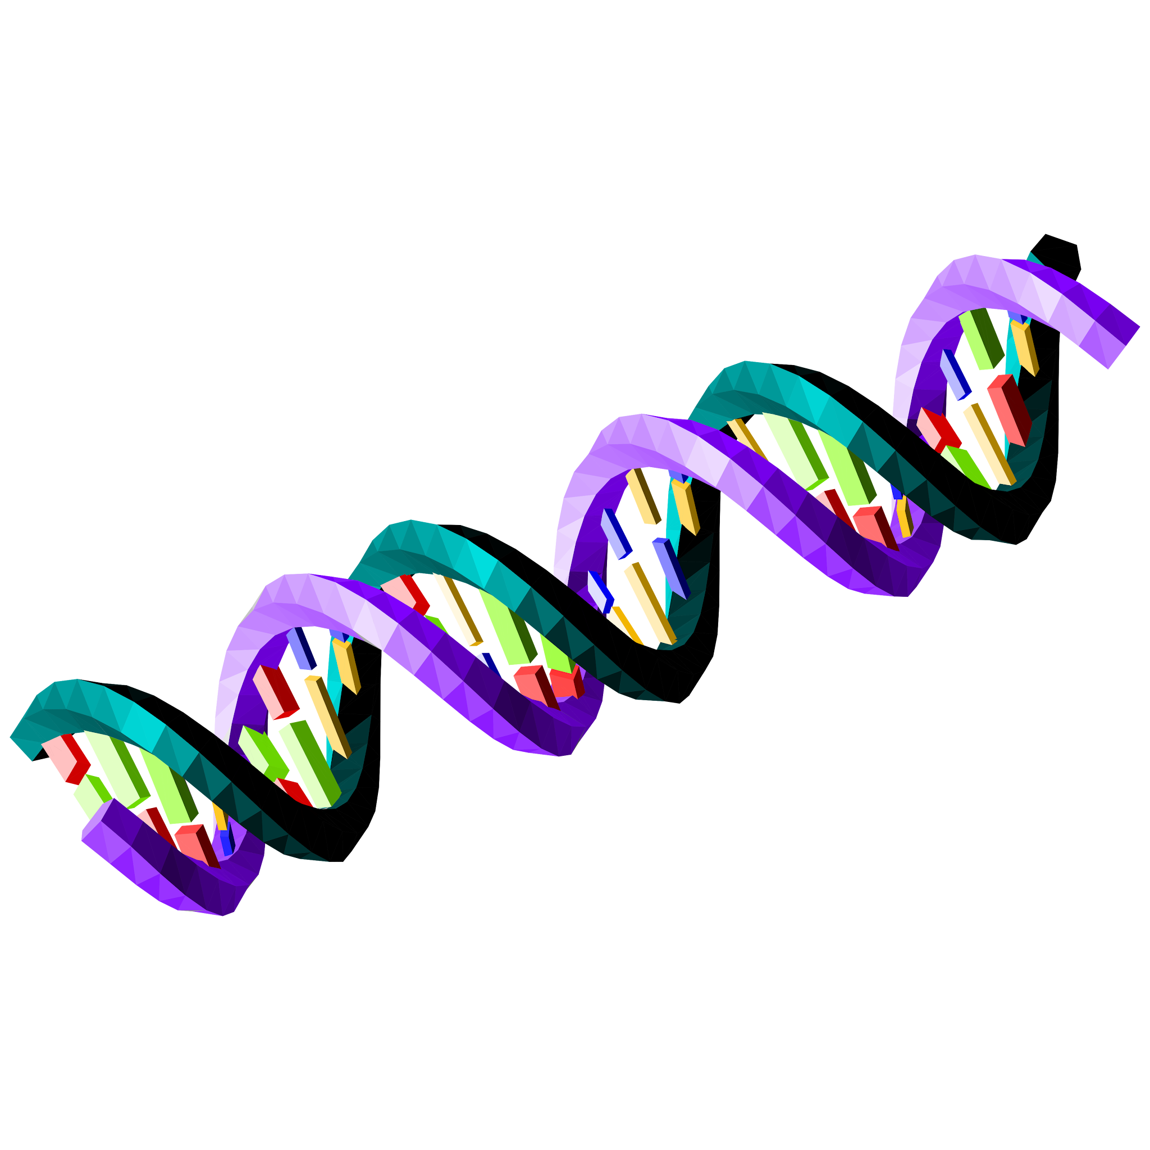

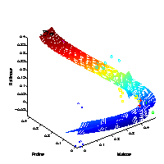
•Design an end‑to‑end biological ML workflow
Convert raw sequences into structured features
Build clustering and classification models
Interpret model output biologically

Slide 17
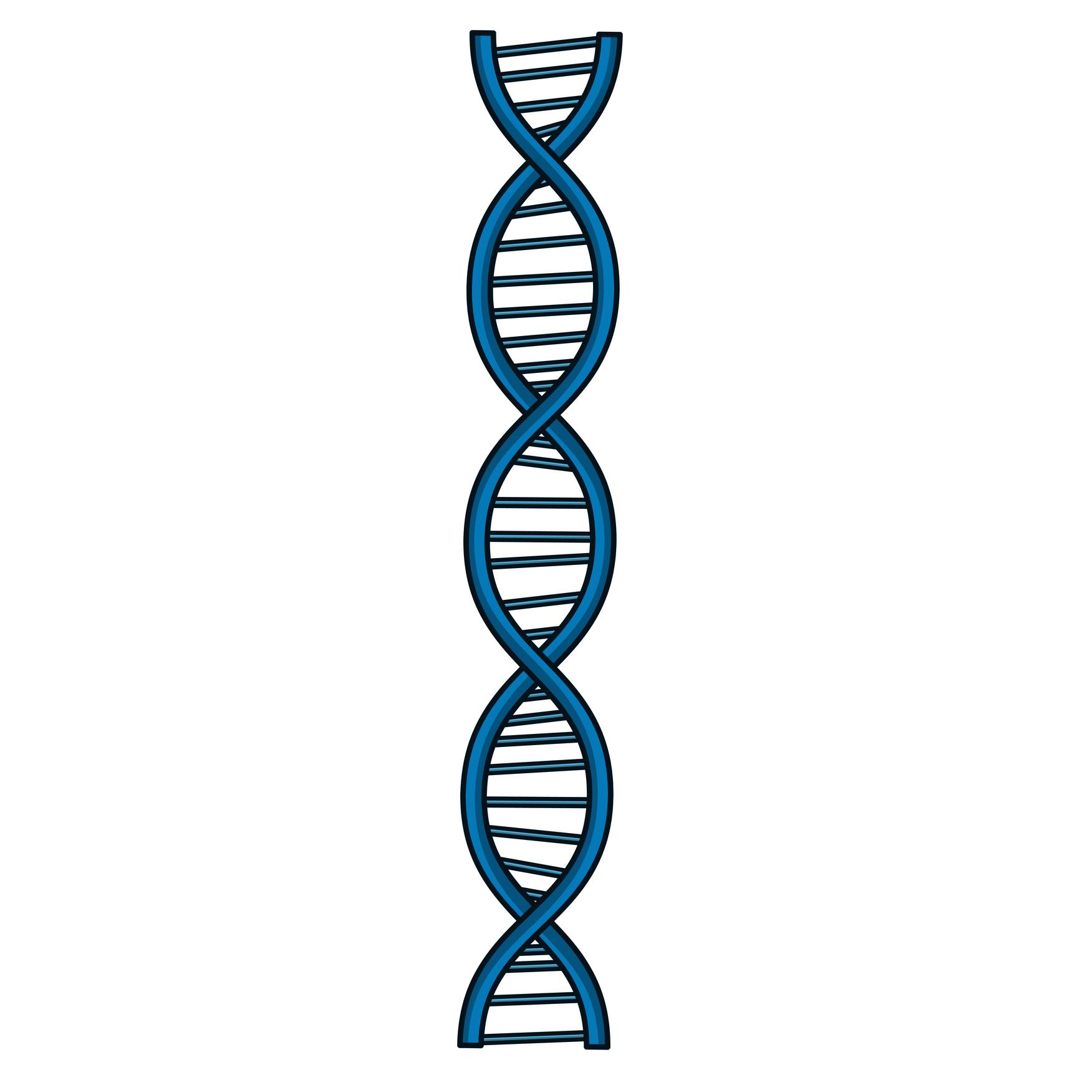
Examples of Real Research Questions
Are certain mutations increasing over time?
1.Can mutation patterns predict collection year?
2.Do samples form natural genetic clusters?
3.Which genomic regions drive divergence?

Slide 18
Translating Biology into Algorithms
Mutation presence → Binary features
Expression levels → Numerical features
Protein sequences → Encoded vectors
Time or phenotype → Target variable
Each scientist uses different methods of experimentation

Slide 19
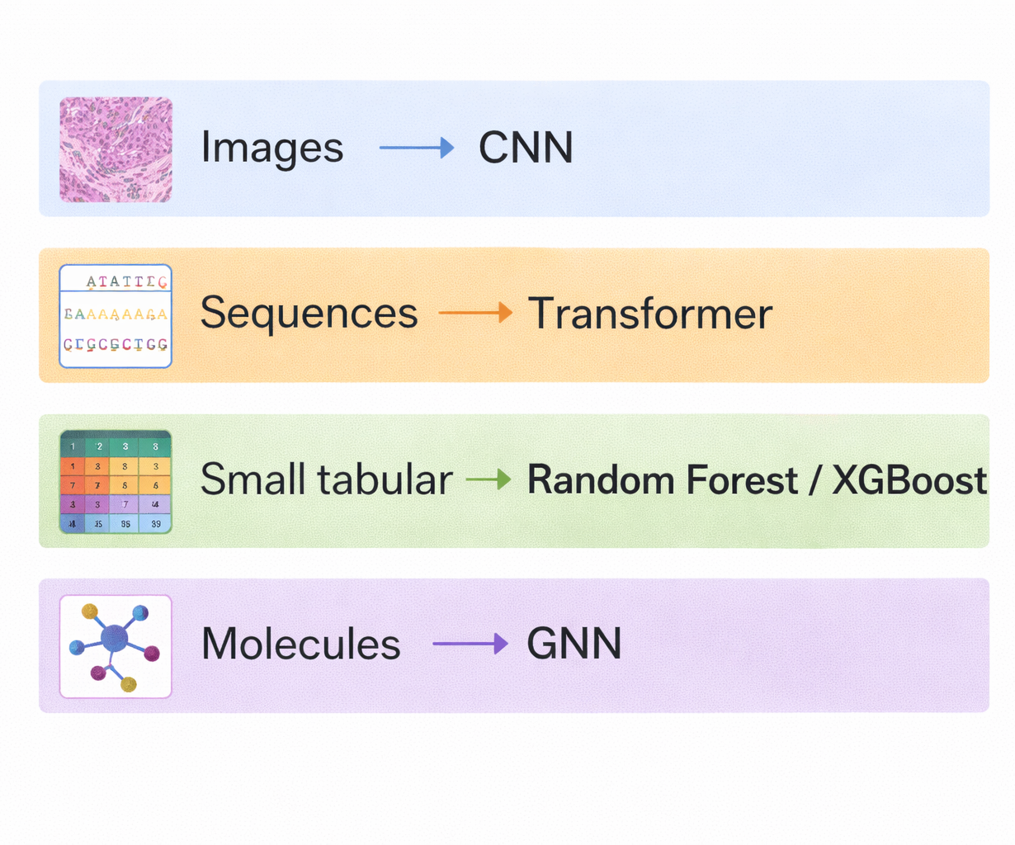
Choosing the Right Type of Model

Slide 20
How to Extend This Framework
–Apply workflow to gene expression datasets
–Scale analysis to thousands of genomes
–Combine multiple data types in one model

Slide 21
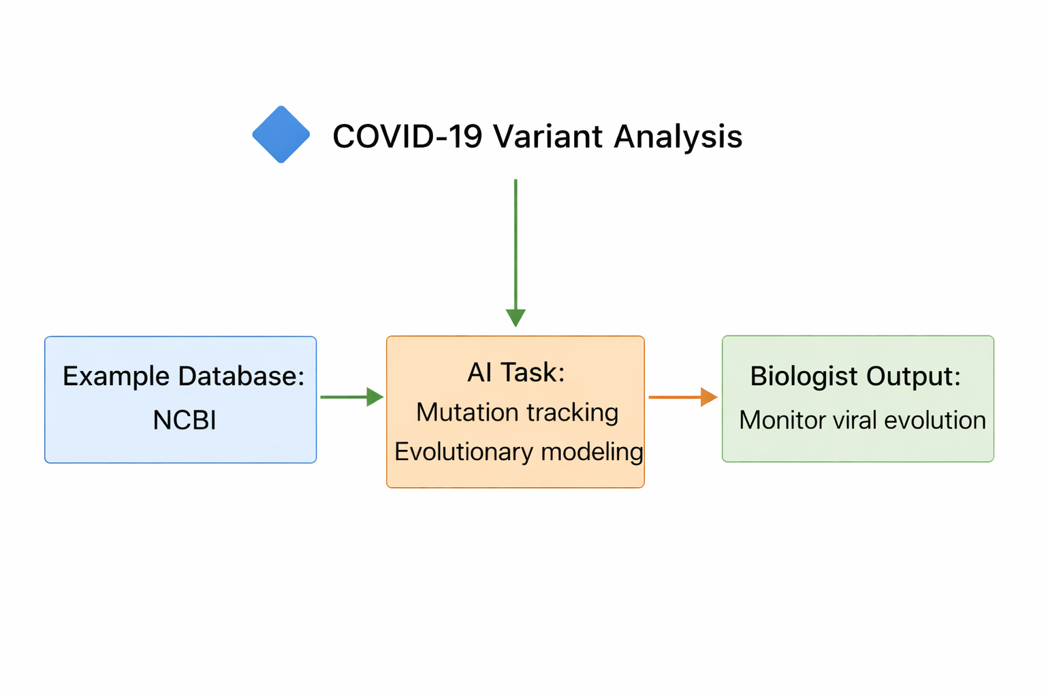
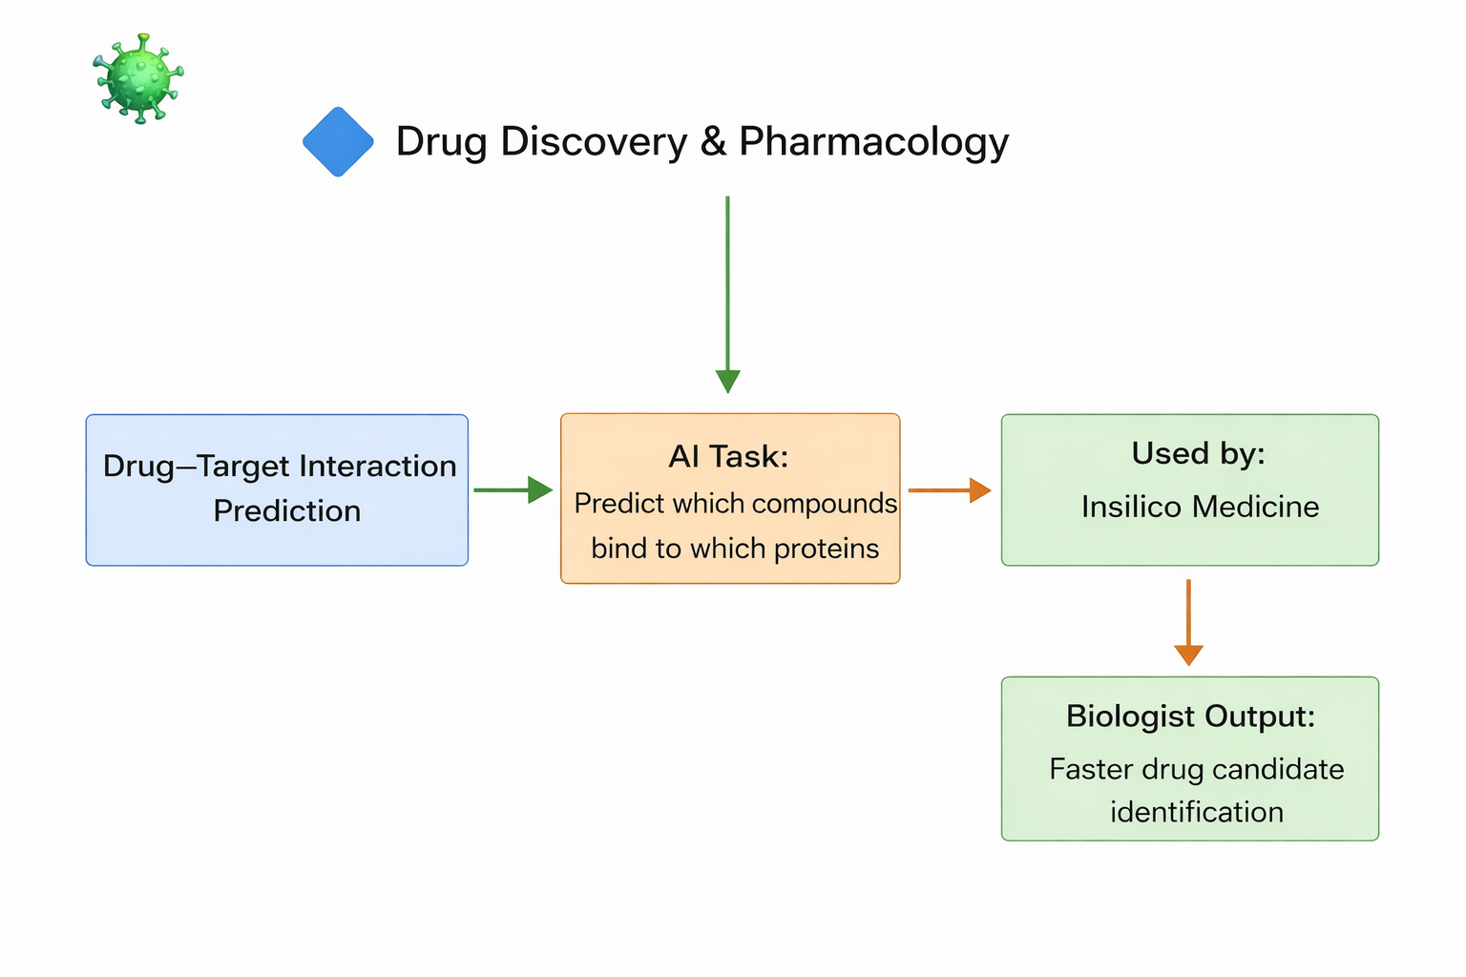
AI Model frameworks:

Slide 22
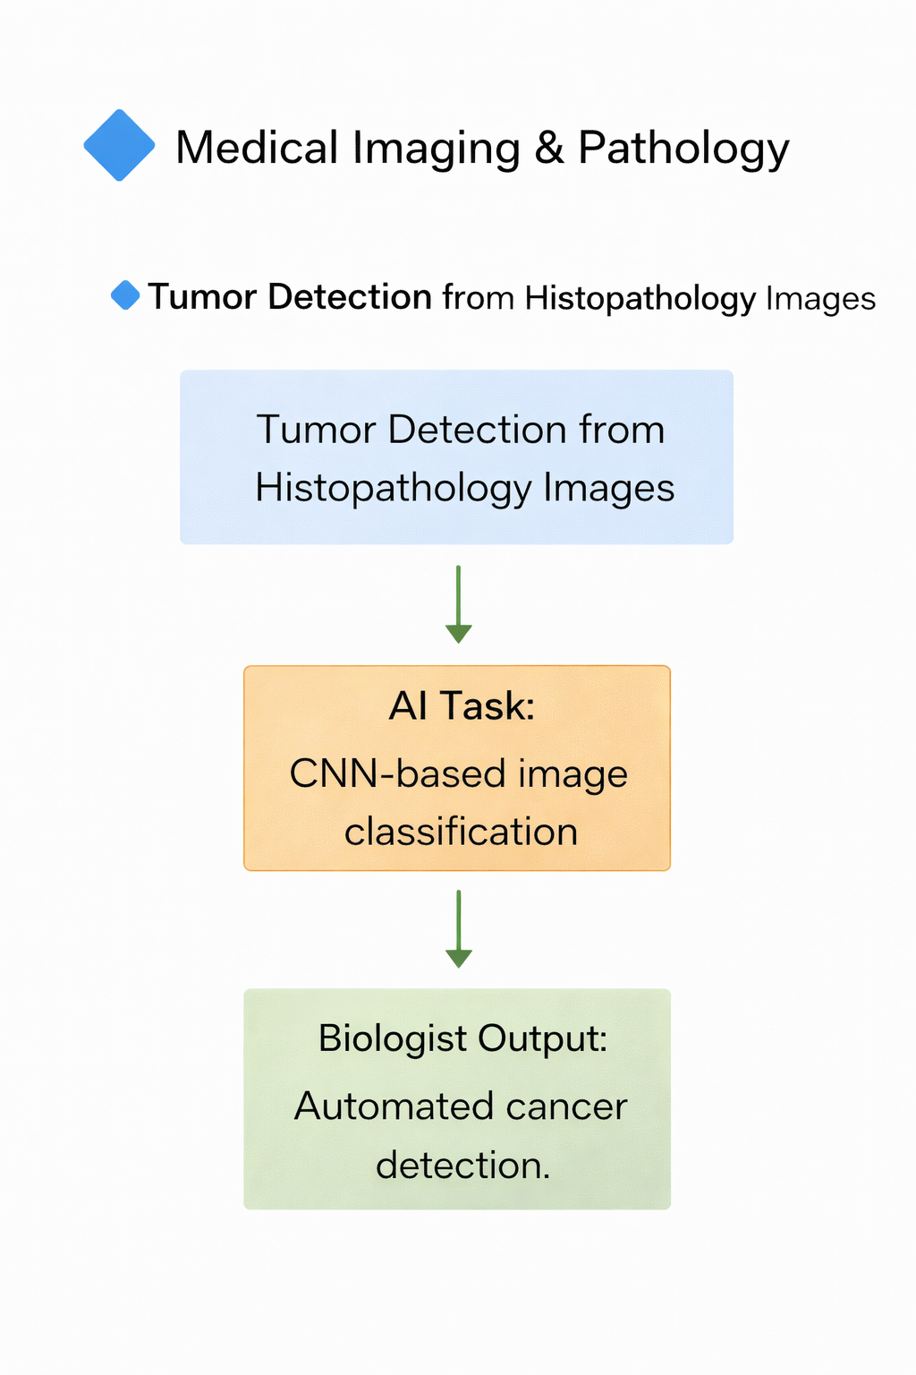
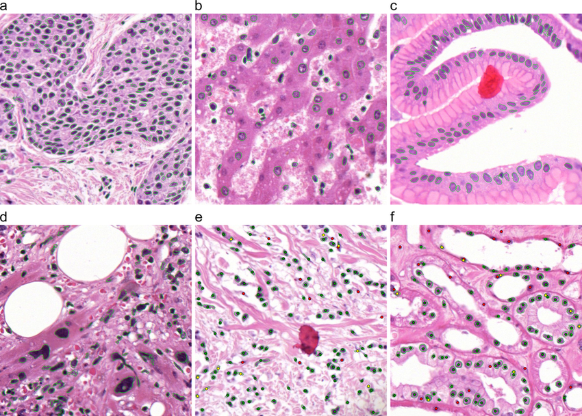
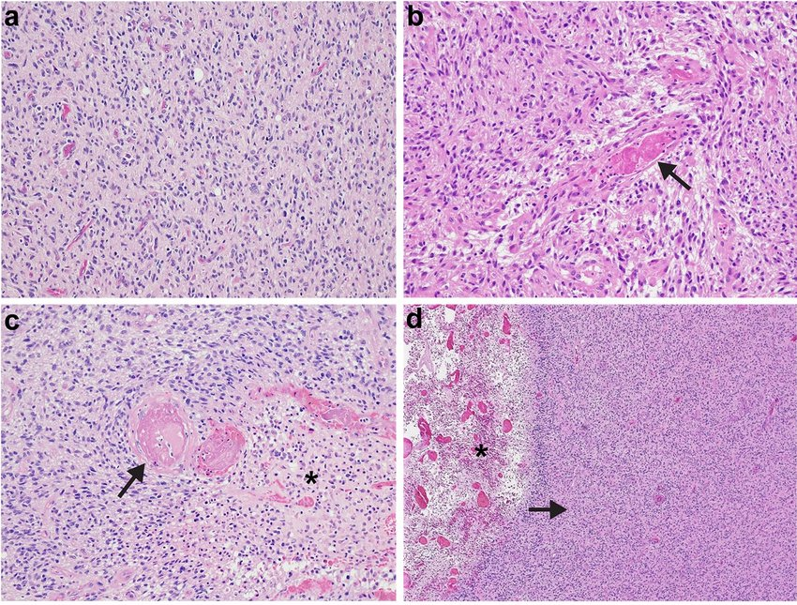
Breast Cancer
Tumor vs normal tissue classification
Brain Tumor
Tumor grading

Slide 23
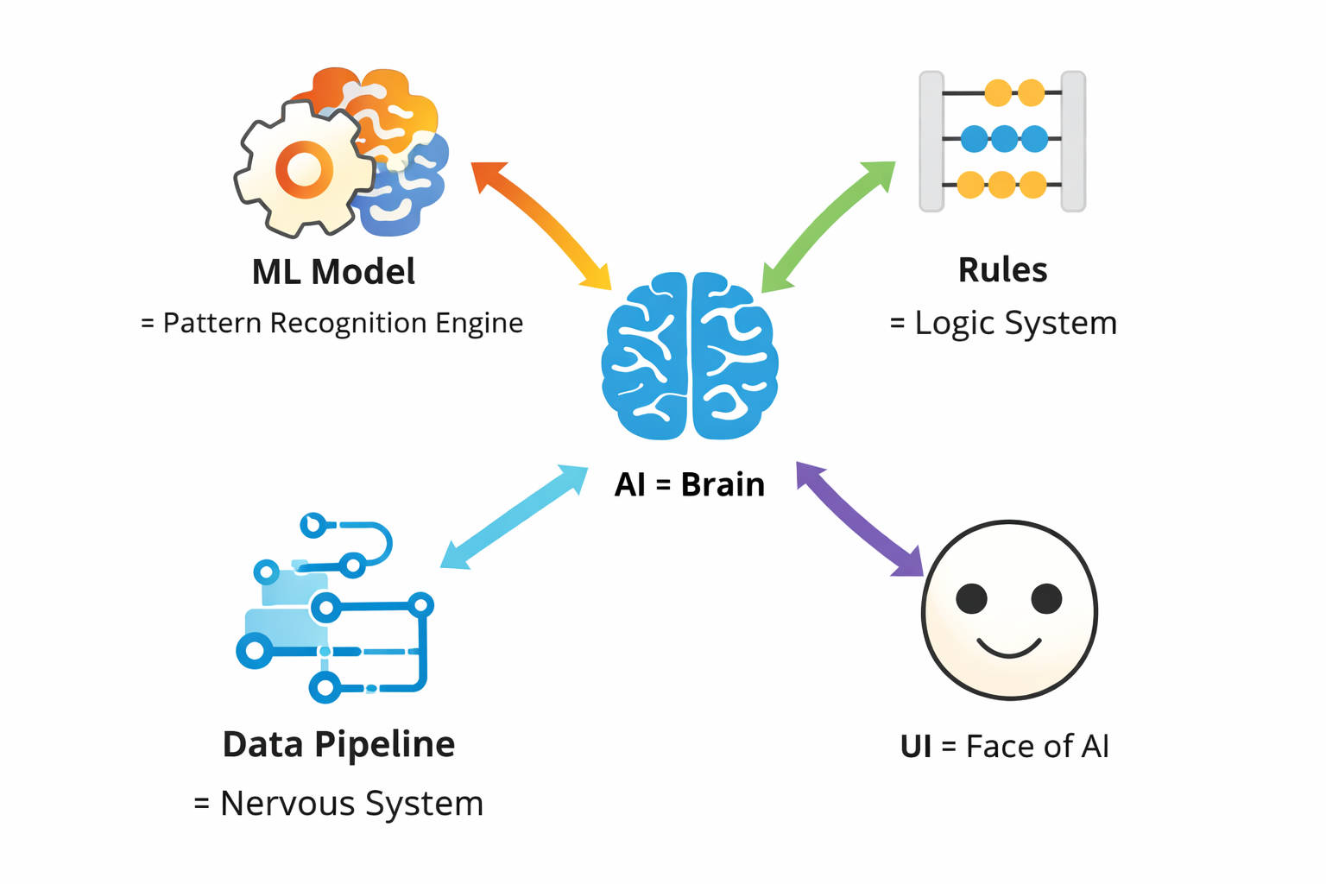
Integration of ML to AI
AI = Brain ML Model = Pattern Recognition Engine Rules = Logic System Data Pipeline = Nervous System UI = Face of AI

Slide 24
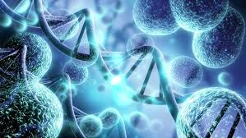
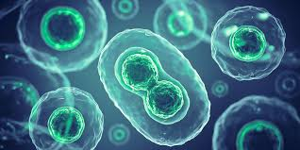
AI Tools for Research
DeepVariant – AI variant calling (genomics)
Enformer – Gene regulation prediction
DeepSEA – Functional variant effect prediction
ProtBERT – Protein language model
AutoDock-GPU – AI-accelerated molecular docking
Insilico Medicine – Generative AI drug discovery
AlphaFold – Protein structure prediction
ESMFold – Fast transformer-based structure prediction
RoseTTAFold – Deep learning protein modeling
ColabFold – Easy cloud-based structure prediction

